Slide 1
CSCI 558L Lecture 4: Internet Protocol
Internetworking and Distributed Systems Laboratory
Young Cho
Department of Computer Science
University of Southern California
Slides adopted from Berkeley and Rice

Slide 2
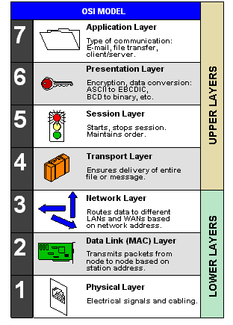
Open System Interconnection Reference Model
From computer desktop encyclopedia © 2004

Slide 3

Internet Protocol
Interconnect many networks
Hide underlying technology
IP is the “compatibility layer”
Hourglass architecture
All hosts and routers run IP
Stateless architecture
Trade-off
No assumptions
No guarantees
email WWW phone...
SMTP HTTP RTP...
TCP UDP…
IP
ethernet PPP…
CSMA async sonet...
copper fiber radio...
Applications
Technology

Slide 4
IPv4 Packet Structure
Ver
Differentiated Services
Ver
IHL
IHL
Type of service
Total length
Total length
Identification (frag id)
Identification
Flags (frag)
Flags
Fragment offset
Fragment offset
Time to live
Time to live
(next) Protocol
Protocol
Header checksum
Header checksum
Source address
Source address
Destination address
Destination address
Option + Padding
Option + Padding
Source Port
Source Port
Destination Port
Destination Port
Sequence Number
Sequence Number
Acknowledgement Number
Acknowledgement Number
Reserved
Offset
Reserved
Offset
U A P R S F
U A P R S F
Window
Window
Checksum
Checksum
Urgent pointer
Urgent pointer
Option + Padding
Option + Padding
Data

Slide 5
Fields of the IPv4 Header
Version (4 bits)
4 for IPv4, 6 for IPv6
Header length (4 bits)
length of IP header, in multiples of 4 bytes
DS/ECN field (1 byte)
This field was previously called as Type-of-Service (TOS) field. The role of this field has been re-defined, but is “backwards compatible” to TOS interpretation
Differentiated Service (DS) (6 bits):
Used to specify scalable service levels (unclear)
Explicit Congestion Notification (ECN) (2 bits):
New feedback mechanism used by TCP

Slide 6
Fields of the IP Header
Identification (16 bits)
Unique identification of a datagram from a host.
Incremented whenever a datagram is transmitted
Flags (3 bits)
First bit always set to 0
DF bit (Do not fragment)
MF bit (More fragments)
Fragment Offset (13 bits)
This field indicates where in the datagram this fragment belongs

Slide 7
Fields of the IP Header
Time To Live (TTL) (1 byte):
Specifies longest paths before datagram is dropped
Role of TTL field: Ensure that packet is eventually dropped when a routing loop occurs
Used as follows:
Sender sets the value (e.g., 64)
Each router decrements the value by 1
When the value reaches 0, the datagram is dropped

Slide 8
Fields of the IP Header
Protocol (1 byte):
Specifies the higher-layer protocol.
Used for demultiplexing to higher layers.
Header checksum (2 bytes):
16-bit long checksum for the header of the datagram

Slide 9
Fields of the IP Header
Options:
Security restrictions
Record Route: each router that processes the packet adds its IP address to the header.
Timestamp: each router that processes the packet adds its IP address and time to the header.
(loose) Source Routing: specifies a list of routers that must be traversed.
(strict) Source Routing: specifies a list of the only routers that can be traversed.
Padding:
Padding bytes are added to ensure that header ends on a 4-byte boundary

Slide 10
Fragmentation
IP packets can be 64KB
Different link-layers have different MTUs
Split IP packet into multiple fragments
IP header on each fragment
Various fields in header to help process
Intermediate router may fragment as needed
Where to do reassembly?
End nodes – avoids unnecessary work
Dangerous to do at intermediate nodes
Buffer space
Multiple paths through network

Slide 11
Fragmentation Disadvantages
Uses resources poorly
Forwarding costs per packet
Best if we can send large chunks of data
Worst case: packet just bigger than MTU
Poor end-to-end performance
Loss of a fragment
Reassembly is hard
Buffering constraints

Slide 12
IP Address Problem (1991)
Address space depletion
In danger of running out of classes A and B
Why?
Class C too small for most domains
Very few class A – IANA (Internet Assigned Numbers Authority) very careful about giving
Class B – greatest problem
Sparsely populated – but people refuse to give it back

Slide 13
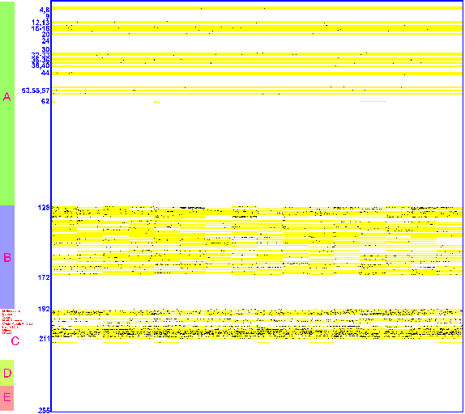
IP Address Utilization (’98)
http://www.caida.org/outreach/resources/learn/ipv4space/

Slide 14
IPv4 Routing Problems
Core router forwarding tables were growing large
Class A: 128 networks, 16M hosts
Class B: 16K networks, 64K hosts
Class C: 2M networks, 256 hosts
32 bits does not give enough space encode network location information inside address – i.e., create a structured hierarchy

Slide 15
Mitigation Efforts
Classless Inter-Domain Routing (CIDR)
Network address translation (NAT)
Use of private network addressing
Name-based virtual hosting of web sites
Tighter control by regional Internet registries on the allocation of addresses to local Internet registries
Network renumbering and subnetting to reclaim large blocks of address space allocated in the early days of the Internet, when the Internet used inefficient classful network addressing

Slide 16
CIDR
Assign multiple class C addresses
Assign consecutive blocks
RFC1338 – Classless Inter-Domain Routing (CIDR)

Slide 17
Classless Inter-Domain Routing
Do not use classes to determine network ID
Assign any range of addresses to network
Use common part of address as network number
e.g., addresses 192.4.16 - 196.4.31 have the first 20 bits in common. Thus, we use this as the network number
netmask is /20, /xx is valid for almost any xx
Enables more efficient usage of address space (and router tables)

Slide 18
NAT
Network Address Translation (NAT)
Alternate solution to address space
Kludge (but useful)
Sits between your network and the Internet
Translates local network layer addresses to global IP addresses
Has a pool of global IP addresses (less than number of hosts on your network)

Slide 19
NAT Illustration
Pool of global IP addresses
Destination
Source
Global Internet
G
P
Private
Network
D_{g}
S_{g}
NAT
Data
D_{g}
S_{p}
Data
Operation: Source (S) wants to talk to Destination (D):
Create S_{g}-S_{p} mapping
Replace S_{p} with S_{g} for outgoing packets
Replace S_{g} with S_{p} for incoming packets
D & S can be just IP addresses or IP addresses + port #’s

Slide 20
IPv6
Scale – addresses are 128bit
Approximately 340 undecillion or 3.4×10³⁸
Header size?
Simplification
Removes infrequently used parts of header
40byte fixed size vs. 20+ byte variable
IPv6 removes checksum
Relies on upper layer protocols to provide integrity
IPv6 eliminates fragmentation
Requires path MTU discovery
Requires 1280 byte MTU

Slide 21
Features of IPv6
Larger Address Space
Aggregation-based address hierarchy
– Efficient backbone routing
Efficient and Extensible IP datagram
Stateless Address Autoconfiguration
Security (IPsec mandatory)
Mobility

Slide 22
Header comparison
0
15
16
31
Removed (6)
vers hlen TOS total length
identification flags flag-offset
ID, flags, flag offset
TOS, hlen
header checksum
20
bytes
TTL protocol header checksum
source address
destination address
Changed (3)
options and padding
total length => payload
protocol => next header
TTL => hop limit
IPv4
vers traffic class flow-label
Added (2)
payload length next header hop limit
traffic class
flow label
40
bytes
source address
Expanded
destination address
address 32 to 128 bits
IPv6

Slide 23
Changes
Streamlined
Fragmentation fields moved out of base header
IP options moved out of base header
Header Checksum eliminated
Header Length field eliminated
Length field excludes IPv6 header
Alignment changed from 32 to 64 bits
Revised
Time to Live to Hop Limit
Protocol to Next Header
Precedence & TOS to Traffic Class
Addresses increased 32 bits to 128 bits
Extended
Flow Label field added

Slide 24
Extension Headers
Routing – Extended routing, like IPv4 loose list of routers to visit
Fragmentation – Fragmentation and reassembly
Authentication – Integrity and authentication, security
Encapsulation – Confidentiality
Hop-by-Hop Option – Special options that require hop-by-hop processing
Destination Options – Optional information to be examined by the destination node

Slide 25
Extension Headers
IPv6 header
TCP header + data
next header =
TCP
IPv6 header
Routing header
TCP header + data
next header =
Routing
next header =
TCP
IPv6 header
Routing header
Fragment header
fragment of TCP
header + data
next header =
Routing
next header =
Fragment
next header =
TCP

Slide 26
Extension Headers
Generally processed only by node identified in IPv6 Destination Address field
much lower overhead than IPv4 options processing
exception: Hop-by-Hop Options header
Eliminated IPv4’s 40-byte limit on options
in IPv6, limit is total packet size, or Path MTU in some cases
Currently defined extension headers:
Fragment, Hop-by-Hop Options, Routing, Authentication, Encryption, Destination Options

Slide 27
Fragment Header
Next Header
Reserved
Fragment Offset
0 0 M
Original Packet Identifier
IPv6 fragmentation & reassembly is an end-to-end
Routers do not fragment packets
If packet is too big they send ICMP "packet too big"

Slide 28
128-bit IPv6 Address
3FFE:085B:1F1F:0000:0000:0000:00A9:1234
8 groups of 16-bit hexadecimal numbers separated by “:”
Leading zeros can be removed
3FFE:85B:1F1F::A9:1234
:: = all zeros in one or more group of 16-bit hexadecimal numbers

Slide 29
Text Representation
"Preferred" form: 1080:0:FF:0:8:800:200C:417A
Compressed form: FF01:0:0:0:0:0:0:43
becomes FF01::43
IPv4-mapped: 0:0:0:0:0:FFFF:10.1.68.3
or ::FFFF:10.1.68.3

Slide 30
Address Allocation
/23
/32
/48
/64
2001
0410
Interface ID
Registry
ISP prefix
Site prefix
Subnet prefix
The allocation process was recently updated by the registries:
International Assigned Numbers Authority (IANA) allocates from 2001::/16 to regional registries
Each regional registry allocation is a ::/23
ISP allocations from the regional registry is a ::/36 (immediate allocation) or ::/32 (initial allocation) or shorter with justification
Policy expectation that an ISP allocates a ::/48 prefix to each customer
Notes:
The generic allocation process is:
IANA allocates 2001::/16 to registries from the full address space
Slow-start allocation process:
Each registry gets a /23 prefix from IANA, within the 2001::/16 space
Registry allocates an initial /35 prefix to a new IPv6 ISP
ISP allocates a /48 prefix (out of the /35) to each customer
The slow-start allocation process is there to minimize the initial space given to an ISP. This enforces the conservation of addresses.
Cisco managed to receive a /35 prefix: 2001:0420::/35.

Slide 31
Preview: Transport vs. Network
Network layer: logical communication between hosts
Transport layer: logical communication between processes
relies on, enhances, network layer services
Postal service analogy:
kids sending letters to other kids
processes = kids
app messages = letters in envelopes
hosts = houses
transport protocol = two specific kids
network-layer protocol = postal service

Slide 32

Internet transport-layer protocols
Reliable, in-order delivery (TCP)
congestion control
flow control
connection setup
Unreliable, unordered delivery: UDP
no-frills extension of “best-effort” IP
Services not available:
delay guarantees
bandwidth guarantees
application
transport
network
data link
physical
network
data link
physical
network
data link
physical
network
data link
physical
logical end-end transport
network
data link
physical
network
data link
physical
network
data link
physical
application
transport
network
data link
physical

Slide 33
UDP: User Datagram Protocol [RFC 768]
“no frills,” “bare bones” Internet transport protocol
“best effort” service, UDP segments may be:
lost
delivered out of order to app
connectionless:
no handshaking between UDP sender, receiver
each UDP segment handled independently of others
Why is there a UDP?
no connection establishment (which can add delay)
simple: no connection state at sender, receiver
small segment header
no congestion control: UDP can blast away as fast as desired

Slide 34
TCP: Overview RFCs: 793, 1122, 1323, 2018, 2581
full duplex data:
bi-directional data flow in same connection
MSS: maximum segment size
connection-oriented:
handshaking (exchange of control msgs) init’s sender, receiver state before data exchange
flow controlled:
sender will not overwhelm receiver
point-to-point:
one sender, one receiver
reliable, in-order byte steam:
no “message boundaries”
pipelined:
TCP congestion and flow control set window size
send & receive buffers

Slide 35
TCP seq. #’s and ACKs
Seq. #’s:
byte stream “number” of first byte in segment’s data
ACKs:
seq # of next byte expected from other side
cumulative ACK
Host A
Host B
User
types
‘C’
Seq=42, ACK=79, data = ‘C’
host ACKs
receipt of
‘C’, echoes
back ‘C’
Seq=79, ACK=43, data = ‘C’
host ACKs
receipt
of echoed
‘C’
Seq=43, ACK=80
time
simple telnet scenario

Slide 36

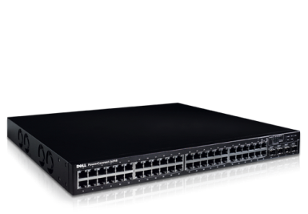

Laboratory 4: Fast and Reliable FTP
Part A
Each group split into 2 subgroups
Competing within each group
Demo both methods on Sept 17th
Full credit for >20 Mbps on 100Mbps/200ms/20% loss
Automated script to determine winner
Extra credit, if your script is used in Part B
100 Mbps
200ms RTT
20% packet loss

Slide 37
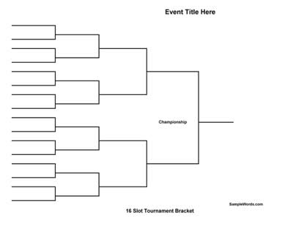
Laboratory 4: Fast and Reliable FTP
Part B
Each group merge the best techniques
Tournament Qualification: >40 Mbps (full credit)
The Tournament
September 24th: tournament at demo
September 25th: the finalists compete in class
The winner(s) will get extra credit
CSCI 558L FTP Tournament

Slide 38
Next
Next Lecture: Network Performance
Laboratory 2 & 3
Socket Programming Tutorial
Due September 6, 2012 at 11:55pm
Measuring Network Performance
Due September 8, 2012 at 11:55pm
Laboratory 4: Fast and Reliable FTP
Part A – Due Sept 15th, demo 17th
Part B – Demo Sept 24th ,Finalists Compete 25th
Reading Assignment
Narten, T., "Internet Routing", ACM SigCom 89.
Please turn the slides in by September 8, 2011 11:55pm for a full credit.

